Slide 1

Corvallis-Benton Public Library
Pi without circles?
Sarah Hagen
Oregon State University
March 14th, 2019

Slide 2


Wait, what is pi again?
$\frac{Circumference}{Diameter}=π$
$π=3.14…$
Circumference
Diameter
$$π=3.1415…$$
Notes:
Pi shows up whenever circles are around. Area of a circle. Volume of a sphere. Volume of a cone. NASA uses 16 digits of pi. Circumference of the universe to within a planck length needs 40 digits. For most purposes 3.14 does just fine.

Slide 3
Buffon’s Needle
This is crazy

Slide 4
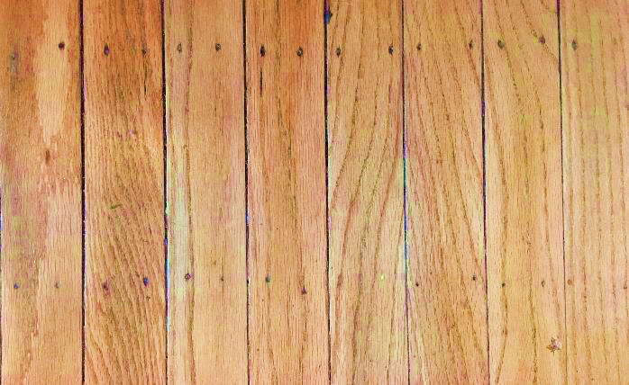
Buffon’s needle experiment
Notes:
Compte de Buffon in 1777. He solved the problem. It was quickly noticed that this led to a probabilistic way of determining pi

Slide 5
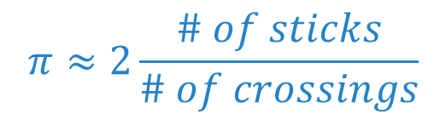
Buffon’s needle experiment
$$π≈2\frac{\# of sticks}{\# of crossings}$$

Slide 6
Where is the circle?
.

Slide 7
Sliding Blocks
This is so crazy

Slide 8

Counting collisions
1kg
1kg
1kg
1kg

Slide 9
Counting collisions
How much bigger?
Number of collisions
How much bigger?
Number of collisions
Same
3
10,000kg
100x
31
1,000,000kg
10,000x
314
100kg
1,000,000x
3,141
1kg
1kg

Slide 10






Where is the circle?
Pythagorean Theorem
$$(x,y)$$
$$x^{2}+y^{2}={(radius)}^{2}$$
$$radius$$
$$y$$
$$x$$
Equation of a circle
$$x^{2}+y^{2}=constant$$

Slide 11



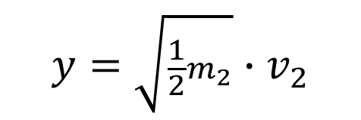
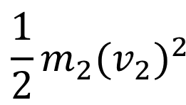

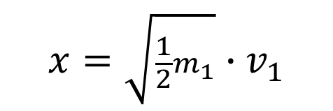
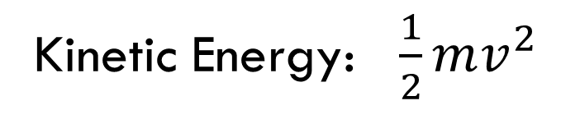
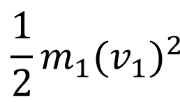



Where is the circle?
Conservation of Energy
$$v_{2}$$
$$\frac{1}{2}m_{1}{(v_{1})}^{2}$$
$$\frac{1}{2}m_{2}{(v_{2})}^{2}$$
$$+$$
$$=constant$$
$$v_{1}$$
$$x=\sqrt{\frac{1}{2}m_{1}}∙v_{1}$$
$$m_{1}$$
$$m_{2}$$
$$y=\sqrt{\frac{1}{2}m_{2}}∙v_{2}$$
Kinetic Energy: $\frac{1}{2}mv^{2}$
$$x^{2}+y^{2}=constant$$
Notes:
Ok, but does this count

Slide 12
Coin flips
Also crazy

Slide 13
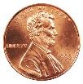
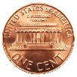
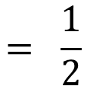
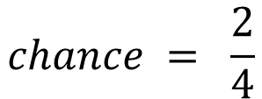
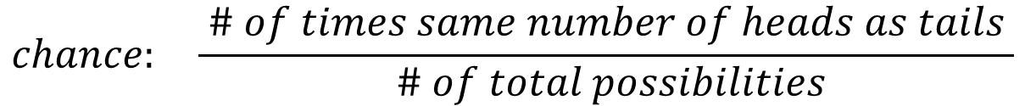
Toss an even number of coins
What is the chance that you get the same number of heads as tails?
$$chance: \frac{ \# of times same number of heads as tails }{ \# of total possibilities}$$
$$chance = \frac{2}{4}$$
$$= \frac{1}{2}$$

Slide 14


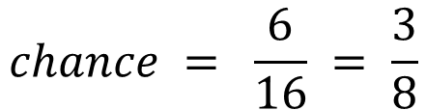
Toss some more coins
$$chance = \frac{6}{16} = \frac{3}{8}$$

Slide 15
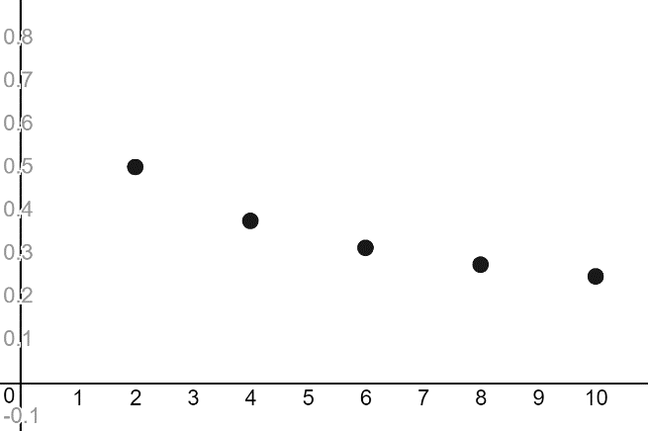
Let’s draw a graph

Slide 16
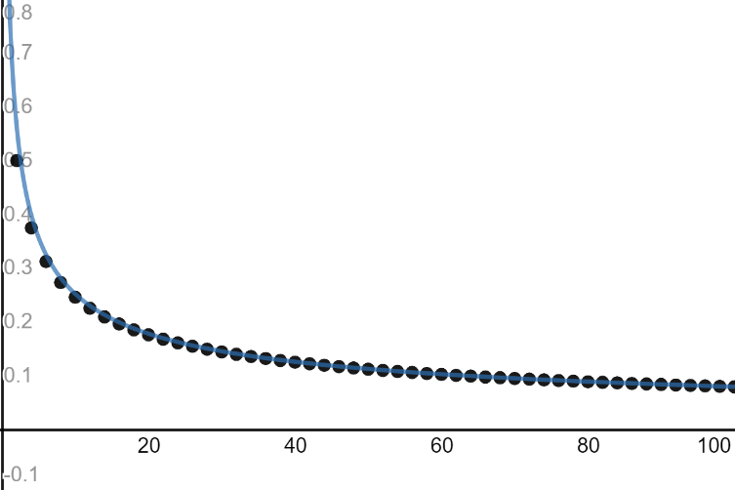
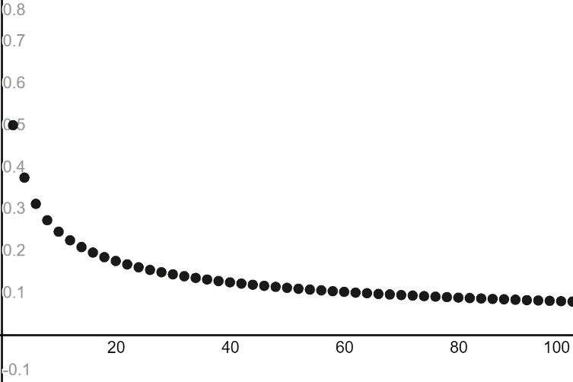

Ok maybe a couple more
$$y=\sqrt{\frac{2}{πx}}$$

Slide 17
Where is the circle?
Don’t ask.
Fine.
It’s there.
Just don’t ask.

Slide 18
Fractals
This is super duper crazy

Slide 19
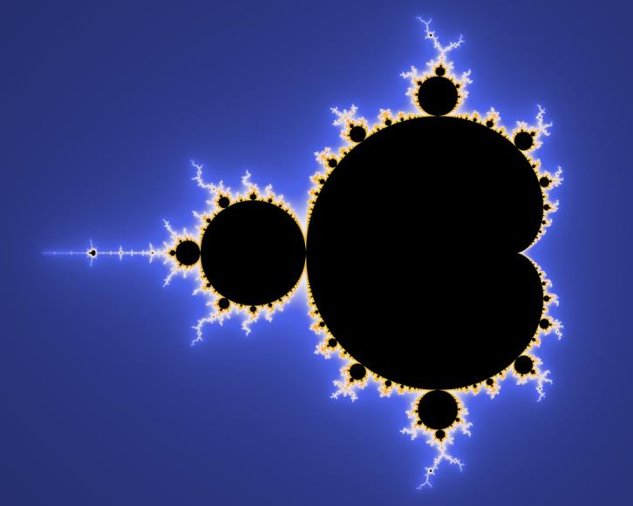
Mandelbrot set
Everyone’s favorite fractal
Notes:
How to define a fractal? Psychadelic mathematics. Mandelbrot himself summarized it as "beautiful, damn hard, increasingly useful. That's fractals."

Slide 20











Where does this even come from???
$$i$$
$$=\sqrt{−1}$$
$$4i$$
$$3i$$
$$2i$$
$$i^{2}=−1$$
$$i$$
$\text{−}6 \text{−5} \text{−}4 \text{ −}3\text{ −}2\text{ −}1 0 1 2 3 4 5 6$
$$\text{−}2i$$
$$3+2i$$
$$\text{−}3i$$
$$\text{−}4i$$
Notes:
Where do imaginary numbers fall on the number line? They don’t!

Slide 21


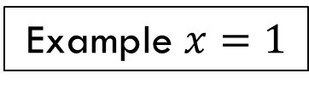




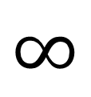




Where does this even come from???
Step 1
Step 2
Step 3
. . .
$$x$$
$$( )^{2}+x$$
$$( )^{2}+x$$
Example $x=1$
Step 1
Step 2
Step 3
Step 4
$$(5)^{2}+1$$
. . .
$$∞$$
$$(2)^{2}+1$$
$$26$$
$$2$$
$$5$$
$$1$$
$$(1)^{2}+1$$

Slide 22



















Where does this even come from???
Step 1
Step 2
Step 3
. . .
$$x$$
$$( )^{2}+x$$
$$( )^{2}+x$$
Step 1
Step 2
Step 3
Step 4
$$−1$$
$$0$$
$$\text{−}1$$
$$0$$
. . .
$$∞$$
$$(\text{−}1)^{2}−1$$
$$(0)^{2}−1$$
$$(\text{−}1)^{2}−1$$
Step 1
Step 2
Step 3
Step 4
$$\frac{5}{16}$$
$$(\frac{89}{256})^{2}+\frac{1}{4}$$
. . .
$$2$$
$$\frac{1}{4}$$
$$(\frac{5}{16})^{2}+\frac{1}{4}$$
$$\frac{24305}{65536}$$
$$(\frac{1}{4})^{2}+\frac{1}{4}$$
$$\frac{89}{256}$$
Notes:
W

Slide 23
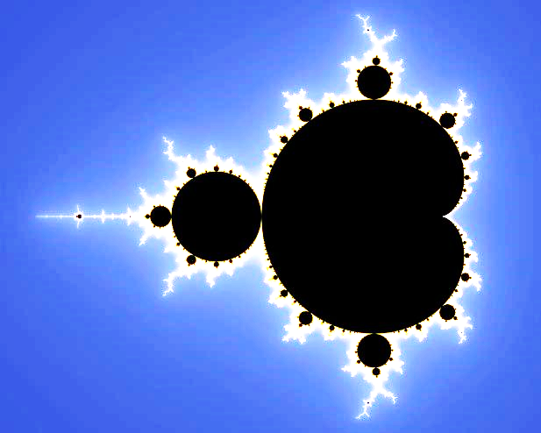




Here’s where it comes from
$$i$$
$$\text{−}2$$
$$1$$
$$\text{−}i$$
Notes:
How to define a fractal? Mandelbrot himself summarized it as "beautiful, damn hard, increasingly useful. That's fractals."

Slide 24




A Teeeeeeeeeeny bit more than 1/4
$$i$$
How much more? | Starting value | How many steps?
1
1.25
2
0.01
0.26
30
$$\text{−}2$$
$$1$$
0.0001
0.2501
315
0.000001
0.250001
3140
0.00000001
0.25000001
31414
$$\text{−}i$$

Slide 25





Where is the circle?
Mandelbrot fractal definition:
$$( )^{2}+x$$
$$2$$
Rewrite as:
$$( )^{2}+(\sqrt{x})^{2}$$
$$2$$
Equation of a circle:
$$(x)^{2}+(y)^{2}=2$$
Is this math or coincidence ???

Slide 26

Is there always a circle hiding in the background?

Slide 27
Infinite sums and products
Just bonkers

Slide 28



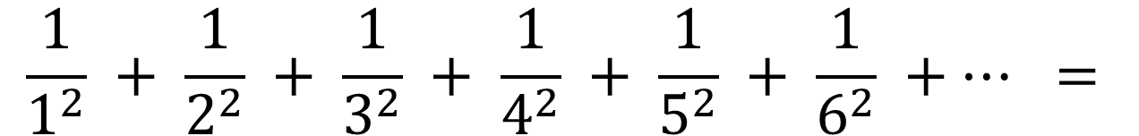
The Basel Problem
$$\frac{1}{1^{2}} + \frac{1}{2^{2}} + \frac{1}{3^{2}} + \frac{1}{4^{2}} + \frac{1}{5^{2}} + \frac{1}{6^{2}} +… =$$
$$?$$
$$?$$
$$?$$

Slide 29


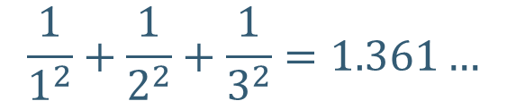
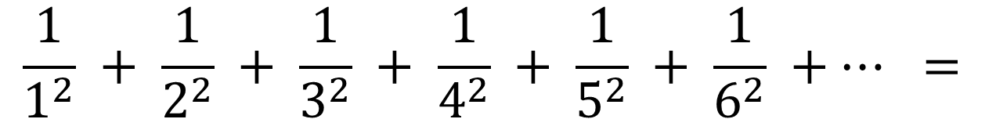
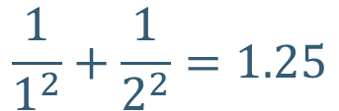



The basel problem
$$\frac{π^{2}}{6}$$
$$\frac{1}{1^{2}} + \frac{1}{2^{2}} + \frac{1}{3^{2}} + \frac{1}{4^{2}} + \frac{1}{5^{2}} + \frac{1}{6^{2}} +… =$$
$$?$$
$$?$$
$$?$$
$$\frac{1}{1^{2}}+\frac{1}{2^{2}}=1.25$$
$$\frac{1}{1^{2}}+\frac{1}{2^{2}}+\frac{1}{3^{2}}=1.361…$$
$$\frac{1}{1^{2}}+\frac{1}{2^{2}}+\frac{1}{3^{2}}+\frac{1}{4^{2}}+\frac{1}{5^{2}}+\frac{1}{6^{2}}+\frac{1}{7^{2}}+\frac{1}{8^{2}}+\frac{1}{9^{2}}+\frac{1}{{10}^{2}}=1.5497…$$

Slide 30
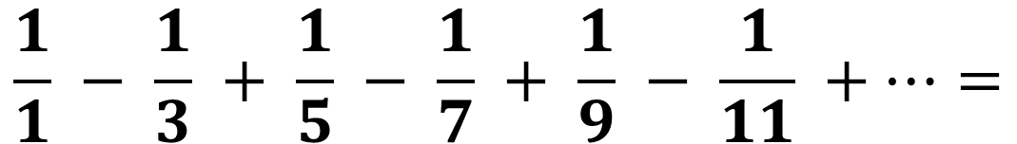


The Leibniz Series
$$\frac{1}{1} − \frac{1}{3} + \frac{1}{5} − \frac{1}{7} + \frac{1}{9} − \frac{1}{11} +…=$$
$$?$$
$$\frac{π}{4}$$
Notes:
Drum roll please

Slide 31
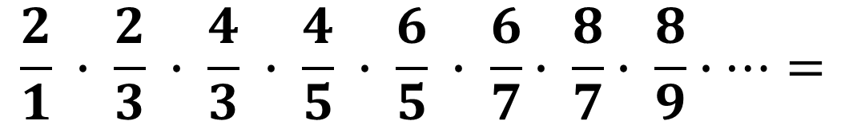

The Wallis Product
$$\frac{2}{1} ∙ \frac{2}{3} ∙ \frac{4}{3} ∙ \frac{4}{5} ∙ \frac{6}{5} ∙ \frac{6}{7}∙ \frac{8}{7}∙ \frac{8}{9}∙…=$$
$$\frac{π}{2}$$
Notes:
Drum roll please

Slide 32



Continued fractions
$$\frac{1}{1+\frac{1^{2}}{3+\frac{2^{2}}{5+\frac{3^{2}}{7+\frac{4^{2}}{⋱}}}}}$$
$$=$$
$$\frac{π}{4}$$
Notes:
Drum roll please

Slide 33
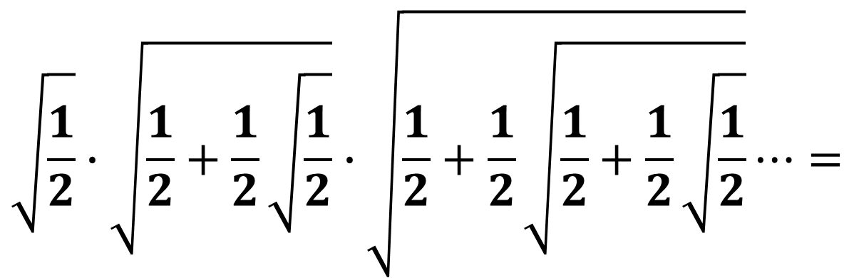

Nested radicals
$$\sqrt{\frac{1}{2}}∙\sqrt{\frac{1}{2}+\frac{1}{2}\sqrt{\frac{1}{2}}}∙\sqrt{\frac{1}{2}+\frac{1}{2}\sqrt{\frac{1}{2}+\frac{1}{2}\sqrt{\frac{1}{2}}}}⋯=$$
$$\frac{2}{π}$$

Slide 34
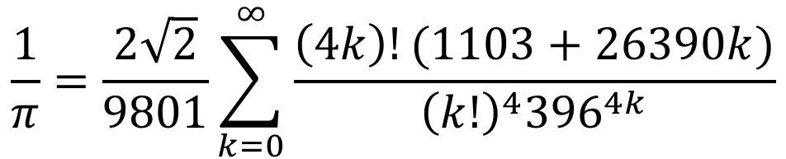
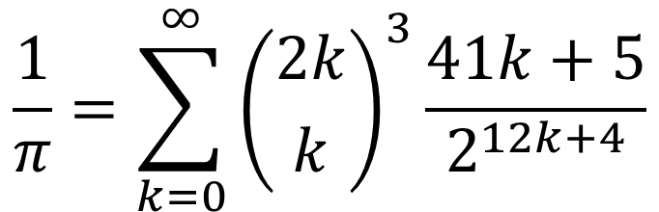
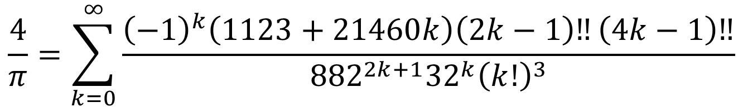
Ramanujan’s equations from the goddess
$$\frac{1}{π}=\frac{2\sqrt{2}}{9801}\sum_{k=0}^{∞}{\frac{\left(4k\right)!(1103+26390k)}{{\left(k!\right)}^{4}{396}^{4k}}}$$
$$\frac{1}{π}=\sum_{k=0}^{∞}{{\left({2k \atop k}\right)}^{3}\frac{41k+5}{2^{12k+4}}}$$
$$\frac{4}{π}=\sum_{k=0}^{∞}{\frac{{\left(−1\right)}^{k}\left(1123+21460k\right)\left(2k−1\right)‼\left(4k−1\right)‼}{{882}^{2k+1}{32}^{k}{\left(k!\right)}^{3}}}$$
Notes:
Drum roll please

Slide 35
The most beautiful equation in mathematics
Yeah. We have one.

Slide 36


$$e^{iπ}+1=0$$

Slide 37

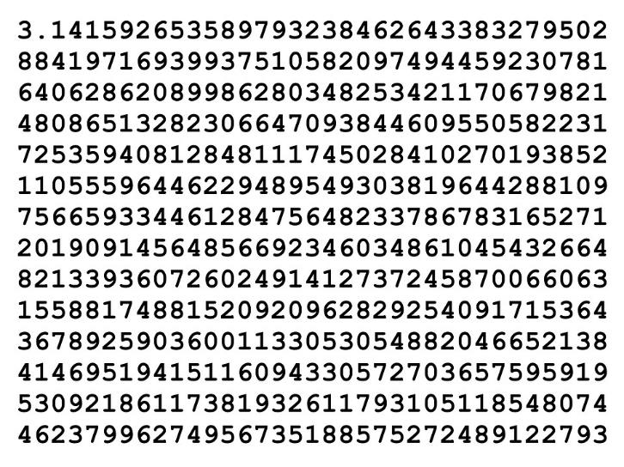
Thank you!

Slide 38
References
Buffon’s needle (explanation and simulation):
https://mste.illinois.edu/activity/buffon/
Coin flips:
https://people.uwec.edu/mbirika/CoinFlipProblem.pdf
Sliding blocks:
https://www.youtube.com/watch?v=jsYwFizhncE
Fractals/Mandelbrot Set:
https://www.youtube.com/watch?v=d0vY0CKYhPY&t=410s

Slide 39
References
Infinite sums and products:
https://en.wikipedia.org/wiki/Approximations_of_%CF%80
http://mathworld.wolfram.com/PiFormulas.html
https://crypto.stanford.edu/pbc/notes/pi/ramanujan.html
https://keisan.casio.com/exec/system/1355104874
https://www.researchgate.net/publication/237548187_GEOMETRIC_CONSTRUCTIONS_APPROXIMATING_p_RELATED_TO_VIETA'S_PRODUCT_OF_NESTED_RADICALS

Slide 40
Image credits
http://www.piday.org/2012/media/
https://pixabay.com/illustrations/mandelbrot-set-fractal-mathematics-979309/
https://people.uwec.edu/mbirika/CoinFlipProblem.pdf

Slide 41
Pi Jokes
What is the official mascot of pi day? The pi-thon
Did you know that 3.14% of seafarers are pi-rates?
What do you call it when you divide the circumference of an igloo by its diameter? Eskimo pi
What do you call it when you divide the circumference of the sun by its diameter? Pi in the sky
Which one of King Arthur’s knights was a mathematician? Sir Cumference. Yes he was a knight of the round table.

