Slide 1
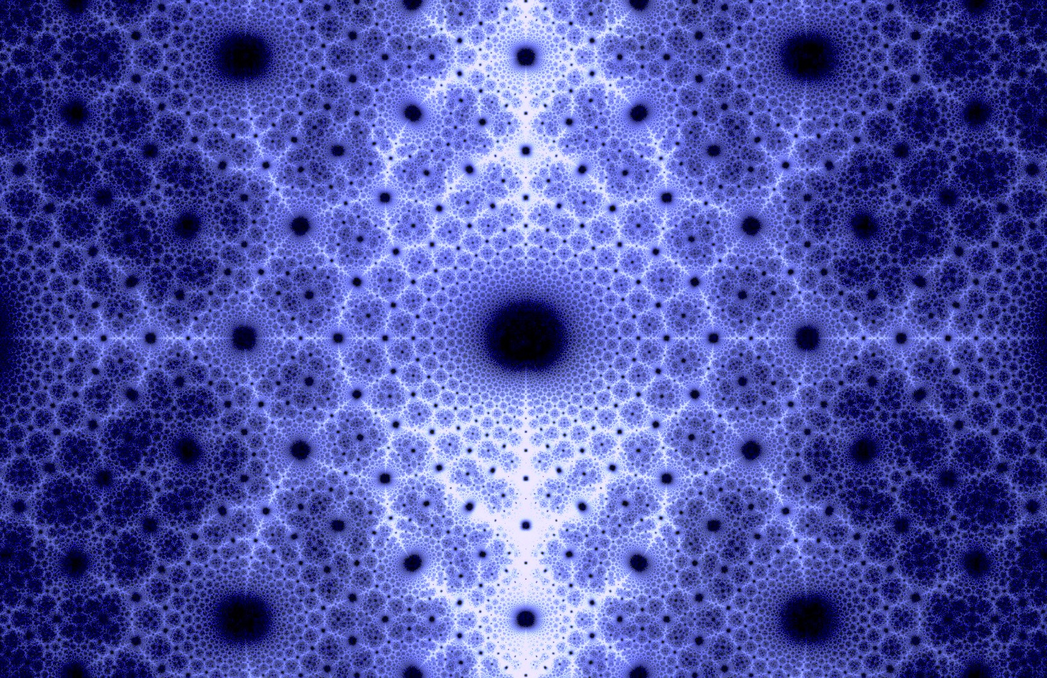
How big is Infinity?
Sarah Hagen, Oregon State University
November 1st, 2018
Notes:
This is an ambitious talk. But the subject matter is so enticing, and the tools to understand it so elementary I couldn’t resist. Not only is it a great mathematical tale, but it is a fascinating personal tale of a man who almost single-handedly created an entire branch of mathematics, and then said of his remarkable results: “I see it, but I don’t believe it”

Slide 2








What is infinity?
$$∞$$
$$∞$$
$$∞$$
$$∞$$
There is no single coherent notion of infinity!
Unending process
The end of a process
Infinitely small/infinitely large
$$∞$$
$$∞$$
$$∞$$
$$∞$$
?
Notes:
[Ask audience for examples of how infinity is used]
We often use “infinite” to mean “unending”. Time is infinite. We talk of infinity as being the end of some process. “It gets bigger and bigger and goes off to infinity”. We talk about things being “infinitely large” and “infinitely small”. Is the universe infinite? Is an electron infinitely small?

Slide 3





Infinity in mathematics
There is no single coherent notion of “infinity” in mathematics!
$$1+2+3+4+5+…=$$
$$∞$$
$$−∞$$
$$∞$$
$$0$$
Notes:
Infinite as a description
Infinity as a kind of number
Infinity as a point on the number line

Slide 4







Infinity As a measure of size
{ , , }
{ 5 , 6 }
$$3 objects$$
$$2 objects$$
{ 1, 2 , 3 , 4 , 5 , 6 , 7 , 8, . . . }
$$∞$$
$$objects$$

Slide 5
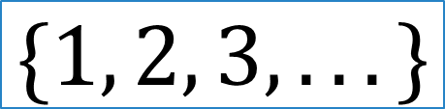
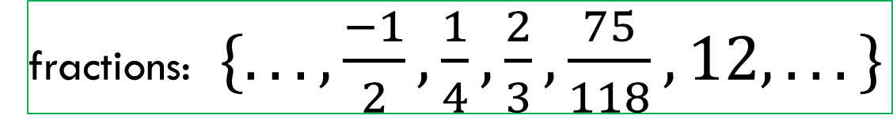
Infinity as a measure of size
$$\{1, 2, 3, . . . \}$$
$$\{. . ., −3, −2, −1, 0, 1, 2, 3, . . . \}$$
fractions: $\{.. .,\frac{−1}{2},\frac{1}{4},\frac{2}{3},\frac{75}{118},12,. . . \}$
all numbers:$\{. ..,−27.38,π,6.03010, . . . \}$
Are these sets the same size?
Is there a coherent notion of infinity as measuring size?
Notes:
Now there are all sorts of infinite sets…

Slide 6
Yes!
But you are going to have to give up something that you love…

Slide 7
A Little history

Slide 8
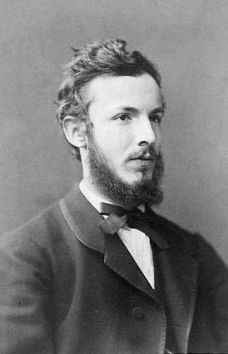
Georg cantor (1845-1918)
Born in Russia, late childhood spent in Germany
At age 23 completed dissertation and appointed lecturer at University of Halle
1878-1884 created a new branch of mathematics devoted to understanding the infinite
Spring 1884 first mental breakdown
Fall 1884 recovered and resumed research
1885 was asked to withdraw research articles from journal run by a close friend
Notes:
The hero of our story. Why mental breakdown?
Studying infinity make him crazy? Or do you have to be crazy to study infinity?
Most prominent mathematicians of his day were vehemently opposed to his work.
Likely he was manic depressive.
Devastated by ask to withdraw. Told publishing would “damage his reputation” and lead to no “significant influence”

Slide 9
“I am convinced that the publication of your new work…will greatly damage your reputation among mathematicians. I know very well that basically this is all the same to you. But if your theory is once discredited in this way, it will be a long time before it will again command the attention of the mathematical world. It may well be that you and your theory will never be given the justice you deserve in your lifetime. Then the theory will be rediscovered in a hundred years or so by someone else, and then it will subsequently be found out that you already had it all. Then, at least, you will be given justice. But in this way [by publishing the article], you will exercise no significant influence…”
--- Letter from Mittag-Leffler

Slide 10
Georg cantor (1845-1918)
Late 1885 left mathematics (temporarily)
1895-97 published grand summary of his theory, work finally recognized
1903 hospitalized again
1913 retired ill and malnourished
1918 died in a sanitorium

Slide 11
A Little activity

Slide 12
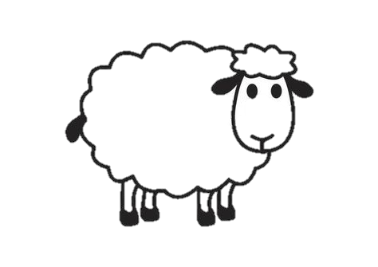


Counting without numbers

Slide 13




Fundamental idea: matching
Two collections of objects are “the same size” if you can match up (one-to-one) objects from each set with no leftovers.

Slide 14













Comparing sizes
$$\{1, 2, 3\}$$
$$\{1, 2, 3\}$$
finite sets: doesn’t matter how you try to match them up
$$\{$$
$$\}$$
$$\{$$
$$\}$$
$$\{1, 2, 3, 4, . . . \}$$
$$\{1, 2, 3, 4, . . . \}$$
Oh dear….
$$\{1, 2, 3, 4, . . . \}$$
$$\{1, 2, 3, 4, . . . \}$$

Slide 15




Fundamental idea: matching
Two collections of objects are “the same size” if you CAN match up (one-to-one) objects from each set with no leftovers.
Call the size of the set of whole numbers
$$\{1, 2, 3, 4, . . . \}$$
$$∞$$
$$\{1, 2, 3, 4, . . . \}$$
Notes:
Any questions?

Slide 16
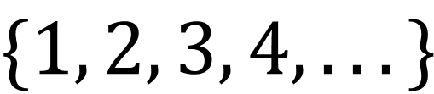
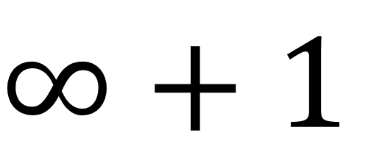
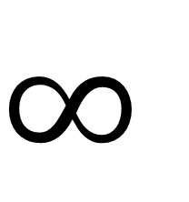
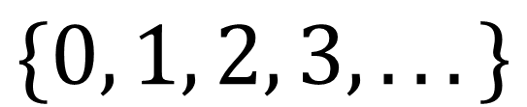
Infinity plus one
$$∞$$
$$\{1, 2, 3, 4,. . . \}$$
$$∞+1$$
$$\{0, 1, 2, 3, . . . \}$$
Notes:
No video or flash photography of this slide. This is just between friends.
Ok! So these sets are the same size. There is even an easy-to-state rule for how to match
The sets are the same size even though one is a proper subset of the other

Slide 17

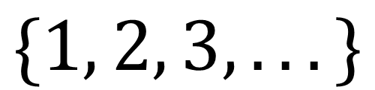
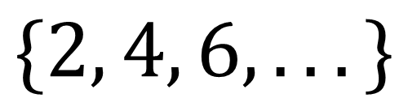
Even numbers vs. Whole numbers
$$\{2, 4, 6, . . . \}$$
Same amount of even numbers as whole numbers!
$$\{1, 2, 3, . . . \}$$
Notes:
Surely there are twice as many whole numbers as even numbers, right?!?!?
Again, we can even come up with a rule. Multiply by 2 (or divide by 2)

Slide 18
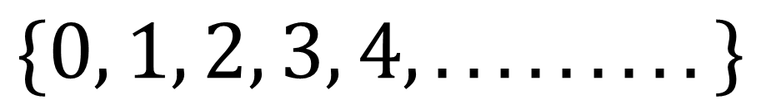
Infinity plus infinity?
$$\{0, 1, 2, 3, 4, . . . . . . . . .\}$$
$$\{. . .−4, −3, −2, −1, 0, 1, 2, 3, 4, . . . . . . . . .\}$$
Notes:
Ok this feels different. One set is unending in one direction, the other is unending in 2 directions

Slide 19
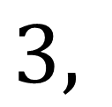
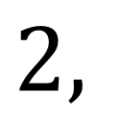
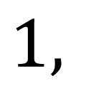
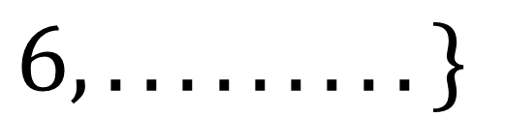
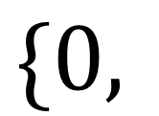
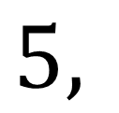
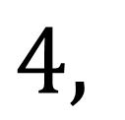
Infinity plus infinity?
$$\{0,$$
$$1,$$
$$2,$$
$$3,$$
$$4,$$
$$5,$$
$$6, . . . . . . . . .\}$$
$$\{0, −1, 1, −2, 2, −3, 3, . . . . . . . . .\}$$

Slide 20

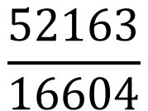
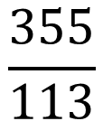




Fractions
Every number of the form $\frac{a}{b}$ where $a$ and $b$ are whole numbers
$$\frac{2}{1}$$
$$\frac{8}{13}$$
$$\frac{1}{2}$$
$$\frac{2}{3}$$
$$\frac{52163}{16604}$$
$$\frac{22}{7}$$
$$\frac{355}{113}$$

Slide 21


































Counting all the fractions
$$1$$
$$2$$
$$3$$
$$4$$
$$5$$
$$6$$
$$\frac{1}{1}$$
$$\frac{2}{1}$$
$$\frac{3}{1}$$
$$\frac{4}{1}$$
$$\frac{5}{1}$$
$$\frac{6}{1}$$
$$1$$
$$2$$
$$\frac{1}{2}$$
$$\frac{2}{2}$$
$$\frac{3}{2}$$
$$\frac{4}{2}$$
$$\frac{5}{2}$$
$$\frac{6}{2}$$
$$1$$
$$2$$
$$3$$
$$4$$
$$5$$
$$6$$
$$7$$
$$. . .$$
$$3$$
$$\frac{1}{3}$$
$$\frac{2}{3}$$
$$\frac{3}{3}$$
$$\frac{4}{3}$$
$$\frac{5}{3}$$
$$\frac{6}{3}$$
$$4$$
$$\frac{1}{4}$$
$$\frac{2}{4}$$
$$\frac{3}{4}$$
$$\frac{4}{4}$$
$$\frac{5}{4}$$
$$\frac{6}{4}$$
$$5$$
$$\frac{1}{5}$$
$$\frac{2}{5}$$
$$\frac{3}{5}$$
$$\frac{4}{5}$$
$$\frac{5}{5}$$
$$\frac{6}{5}$$
Notes:
Any questions?

Slide 22
So are all infinite sets the same size?

Slide 23

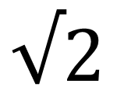
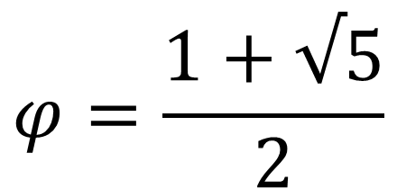
What’s leftover? The irrationals
Irrationals are numbers that cannot be written as a fraction of whole numbers
Irrational numbers have decimals that are never-ending and non-repeating
Irrational numbers “fill in the gaps” in the number line
$$π$$
$$φ=\frac{1+√5}{2}$$
$$√2$$

Slide 24
When are infinite sets not the same size?
Two collections of objects are “the same size” if you can match up (one-to-one) objects from each set with no leftovers.
Two collections of objects are “different sizes” if there is NO WAY to match up (one-to-one) objects from each set without any leftovers.
The goal: to show that any attempt at matching the irrationals with the whole numbers will leave leftover irrationals

Slide 25




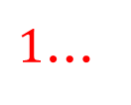





Cantor’s Diagonal argument
$$1$$
$$0.435098630498232345781…$$
$$2$$
$$0.987098704529043538945…$$
$$3$$
$$0.645362450874562984353…$$
This number is not on the list!
$$4$$
$$0.878672341113352837429…$$
$$5$$
$$0.112105400340053467867…$$
$$0.5$$
$$9$$
$$6$$
$$7$$
$1$…

Slide 26
We did it!
There are more numbers between 0 and 1 than fractions on the entire number line!
There are different sizes of infinity!!!!!

Slide 27
Historical reception
Henri Poincare reportedly called Cantor’s work a “disease”
Leopold Kronecker called Cantor a “scientific charlatan”
David Hilbert: “No one shall expel us from the paradise that Cantor has created”

Slide 28
Related results
Is there a smallest infinity?
      Yes! The size of the whole numbers is the smallest
Is there a largest infinity?
      No! There are an infinity of infinities!
Is there an infinity between the infinity of the counting numbers and the infinity of the irrationals?
      We don’t know! This is known as the “Continuum Hypotheses” and has been shown to be independent of the axioms of set theory

Slide 29
Image credits
https://en.wikipedia.org/wiki/Georg_Cantor
https://www.pixcove.com/fractal-textures-nonconcrete-backgrounds-design-project-abstract-pattern-graphics-visuals-complex-mathematics-infinite-graphic-arithmetic-fractals/
http://heavysideindustries.com/wp-content/uploads/2011/08/Dauben-Cantor.pdf

Slide 30
references
Laubenbacher, Reinhard; Pengelley, David. (1999) Mathematical Expeditions. Springer
Wikipedia: https://en.wikipedia.org/wiki/Georg_Cantor
Dauben, Joseph. (2004) "Georg Cantor and the Battle for Transfinite Set Theory"
(PDF), Proceedings of the 9th ACMS Conference (Westmont College, Santa Barbara, CA), pp. 1–22.

Slide 31
Thank you!

Slide 32
Abstract
Did you know that infinity comes in different sizes? In a creative
burst lasting six years, the nineteenth-century German mathematician
Georg Cantor almost single-handedly created an entire field of
mathematics devoted to understanding infinity. By revisiting the most
basic techniques for comparing quantities, Cantor discovered how to
measure infinity, and thereby changed mathematics forever. In this talk,
we will discuss Cantor’s method of comparing infinities as well as the
historical reception of his work. Along the way we will prove all sorts
of crazy facts about infinite sets. All will be explained in detail, and you
will be invited to discover parts yourself. Absolutely no math
background required!

