Slide 1
Ancient Greek Methods of Astronomical Measurement
Sarah Hagen
Oregon State University
August 1st, 2017

Slide 2
How far away is the moon?
1,000 mi
10,000 mi
100,000 mi
1,000,000 mi
10,000,000 mi

Slide 3
How Far away is the sun?
100,000 mi
1,000,000 mi
10,000,000 mi
100,000,000 mi
1,000,000,000 mi

Slide 4
How would you answer if you lived in Antiquity?
Would you have any idea?

Slide 5
One major physical assumption
An extremely distant sun

Slide 6
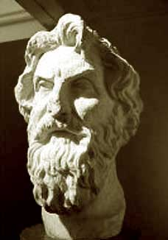
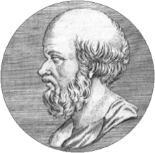
Major Players
Aristarchus
Eratosthenes
c. 310-230 BC
c. 276-194 BC

Slide 7
Size of the Earth

Slide 8
Preliminary Mathematics
Alternate Interior Angles

Slide 9
Preliminary Mathematics
A slightly unorthodox way to talk about angles
$1/4$ of the way around a circle
$1/8$ of the way around a circle
Half-way around a circle

Slide 10
Size of the Earth - ERATOSTHENES
Alexandria
The Well of Syene
Syene

Slide 11
Size of the Earth - ERATOSTHENES
Alexandria
α
α
Syene
α $≈$ $1/{50}$ of a circle
Alexandria to Syene ~5000 stades
$$\frac{1}{50}×Circumference=5000 stades$$
$$Circumference=50×5000 stades=250,000 stades$$

Slide 12
Size of the Earth
How big is a stade?!?!? How good is this measurement?
Olympic Stade $≈$ 610 feet Circumference $≈$ 28,850 mi
15% error
Egyptian Stade $≈$515 feet Circumference $≈$ 24,330 mi
2% error
Actual Circumference $=$ 24,900 mi

Slide 13
Diameter of the Earth
$circumference=π×diameter$
circumference
diameter
$$Diameter=\frac{circumference}{π}≈\frac{28,850 mi}{π}=9,180 mi$$

Slide 14
Lunar measurements

Slide 15
Size of the moon

Slide 16
Size of the Moon - ARISTARCHUS
~ 4 hours for Moon to travel one Earth Diameter
~1 hour for Moon to travel one Moon Diameter
Moon Diameter $≈$ $1/4$ Earth Diameter Moon Diameter = 1,980 mi
Actual Moon Diameter = 2,190 mi 10% error

Slide 17
Complications in the Measurement
What do you think?
Choosing the longest eclipse
Shadow is not exact size of the Earth
Lunar orbit is an arc, not a line

Slide 18
Distance to the Moon

Slide 19
Preliminary Mathematics
When do we say that two triangles are the same kind?
c
2c
b
2b
a
2a
$$\frac{bottom side}{left side}$$
$$\frac{a}{b}$$
=
$$\frac{2a}{2b}$$
Same for both triangles

Slide 20
Distance to the Moon – ARISTARCHUS
Hold a coin up so that it just covers the moon in your field of vision
$$\frac{Moon Distance}{Moon Diameter}=\frac{Coin Distance}{Coin Diameter}$$
$$\frac{Moon Distance}{2,160 mi}=\frac{110}{1}$$
$$Moon Distance=237,600 mi$$

Slide 21
Solar measurements

Slide 22
Distance to the Sun

Slide 23
Distance to the Sun - ARISTARCHUS
α
$$α≈87°$$
$$\frac{Distance to sun}{Distance to Moon}=\frac{b}{a}$$
$$3°$$
a
$$\frac{Distance to sun}{238,900 mi}=19.1$$
$$87°$$
b
$$Distance to Sun=4,500,000 mi$$

Slide 24
Distance to the Sun
How good is this measurement?
The actual distance to the sun is 96,000,000 mi 95% error!!! What happened???
The correct angular measurement for α is 89.85°
The level of accuracy needed to even be in the correct order of magnitude was
beyond that of the instruments available at the time
This did establish a lower bound though

Slide 25
Size of the Sun

Slide 26
Size of the Sun
Could try the coin trick again… but there are problems
Moon almost perfectly covers the sun during solar eclipse
$$\frac{Diameter of Sun}{Distance to Sun}=\frac{Diameter of Moon}{Distance to Moon}$$
$$Diameter of Sun=840,000 mi$$
(using actual distances)
Actual value = 865,000 mi 3% error

Slide 27
How do we calculate these things now?
EARTH size: Satellites and light beams
MOON distance: Light beams
MOON diameter: Very similar to the Greek method!
SUN distance: We use the EXACT same trick as the Greeks! (using other planets instead of the moon)

Slide 28
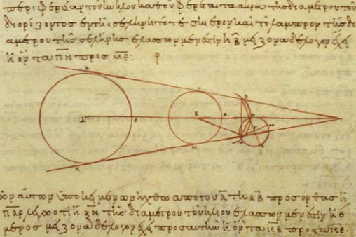
Thank you!

Slide 29
REFERENCES:
Singh, Simon. The Big Bang. New York: Harper Collins. 2004
Heath, Thomas. A History of Greek Mathematics Volumes 1 and 2. New York: Dover. 1981
Stern, David P. “How distant is the moon?” (1) and (2). From Stargazers to Starships. Last updated 18 September 2004.
http://www-spof.gsfc.nasa.gov/stargaze/Smap.htm
“On sizes and distances (Aristarchus)”. Wikipedia. Last updated 12 May 2016.
https://en.wikipedia.org/wiki/On_the_Sizes_and_Distances_(Aristarchus)
“Aristarchus of Samos”. Wikipedia. Last updated 20 June 2016.
https://en.wikipedia.org/wiki/Aristarchus_of_Samos
“Eratosthenes”. Wikipedia. Last updated 27 July 2016.
https://en.wikipedia.org/wiki/Eratosthenes
“Lunar Eclipse Page”. NASA Eclipse Website. Last updated 14 February 2016.
http://eclipse.gsfc.nasa.gov/lunar.html
Saintonge, Amelie. “How do we measure the size of the Moon and of the Sun?” Ask an Astronomer. Last updated 18 July 2015.
http://curious.astro.cornell.edu/about-us/44-our-solar-system/the-moon/general-questions/117-how-do-we-measure-the-size-of-the-moon-and-of-the-sun-beginner

Slide 30
REFERENCES (continued):
Pandian, Jagadheep. “How do you measure the distance between the Earth and the Sun?” Ask an Astronomer. Last updated 30 Jan 2016.
http://curious.astro.cornell.edu/about-us/41-our-solar-system/the-earth/orbit/87-how-do-you-measure-the-distance-between-earth-and-the-sun-intermediate
Subramanian, Ganesh. “When and how did scientists measure the radius of the earth?” Quora. 1 June 2015
https://www.quora.com/When-and-how-did-scientists-measure-the-radius-of-the-earth

